Slide 1

Beyond Buzzwords: Human-Centred AI in International Admissions

Slide 2

What is Artificial Intelligence?
”computing systems that are able to engage in human-like processes such as learning, adapting, synthesizing, self-correction and use of data for complex processing tasks”
Popenici, S. A. D., & Kerr, S. (2017). Exploring the impact of artificial intelligence on teaching and learning in higher education. Research and Practice in Technology Enhanced Learning, 12(1), 22.
“An AI system is a machine-based system that, for explicit or implicit objectives, infers, from the input it receives, how to generate outputs such as predictions, content, recommendations, or decisions that can influence physical or virtual environments.”
OECD, November 2023, retrieved from: https://oecd.ai/en/ai-principles

Slide 3
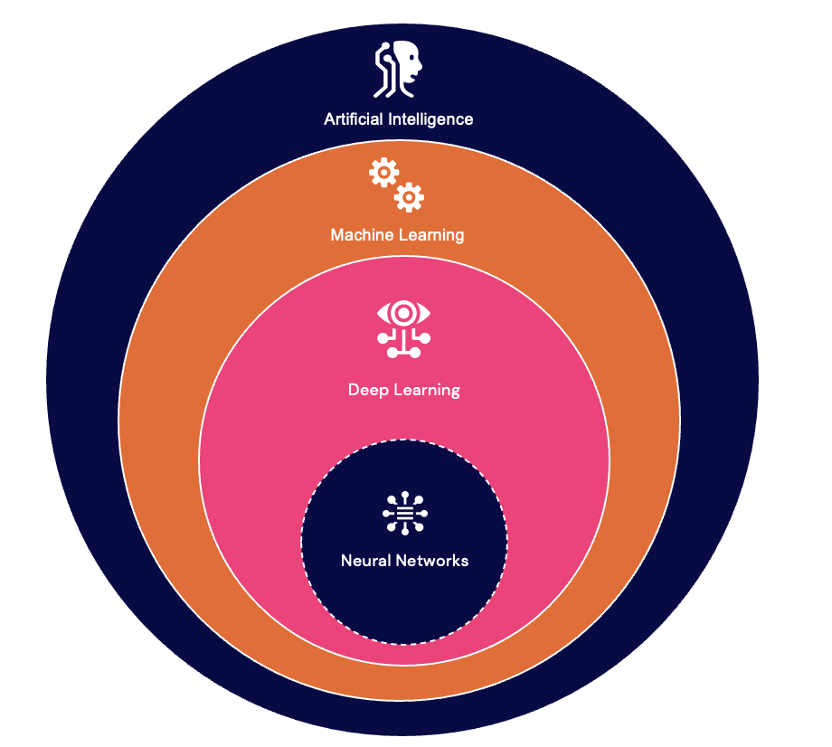
What Artificial
Intelligence isn’t
ChatGPT
Gemini
Claude
Perplexity
Firefly
Generative AI
The AI field goes back to 1950’s in terms
of terminology and technology but even further back

Slide 4



Jean-Marc Côté,1899

Slide 5





Slide 6
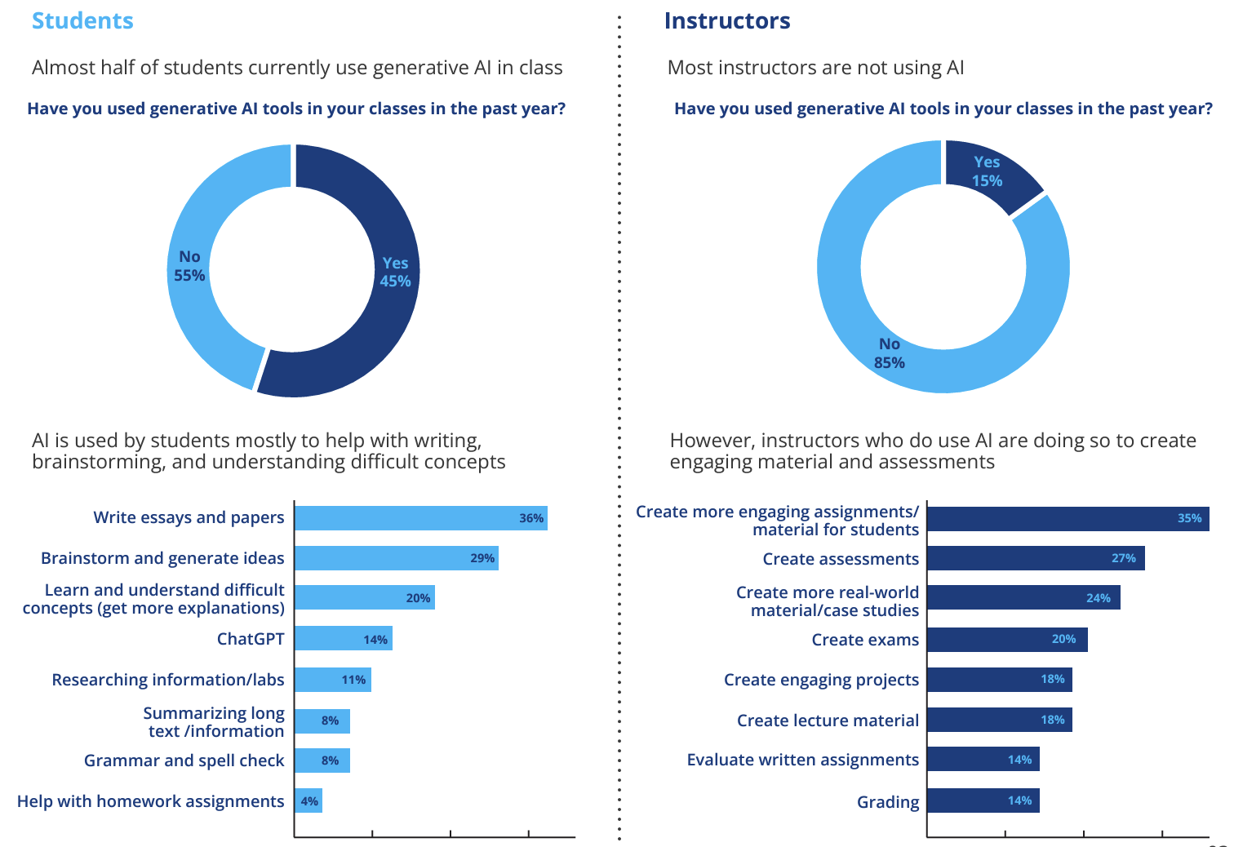
Who is Using Generative AI the most?
Students (CanvaCon, 2024)
Students (Wiley, 2024)
Students (OpenAI Education
Forum, 2024)
”Students who are heavy AI users raise
their hands less in class and ask
fewer questions” – E. Mollick (OpenAi Ed Forum)
The Latest Insights into Academic Integrity Instructor & student experiences, attitudes, and the impact of AI 2024 update, n = 3000
(Wiley, 2024)
3000 sample

Slide 7
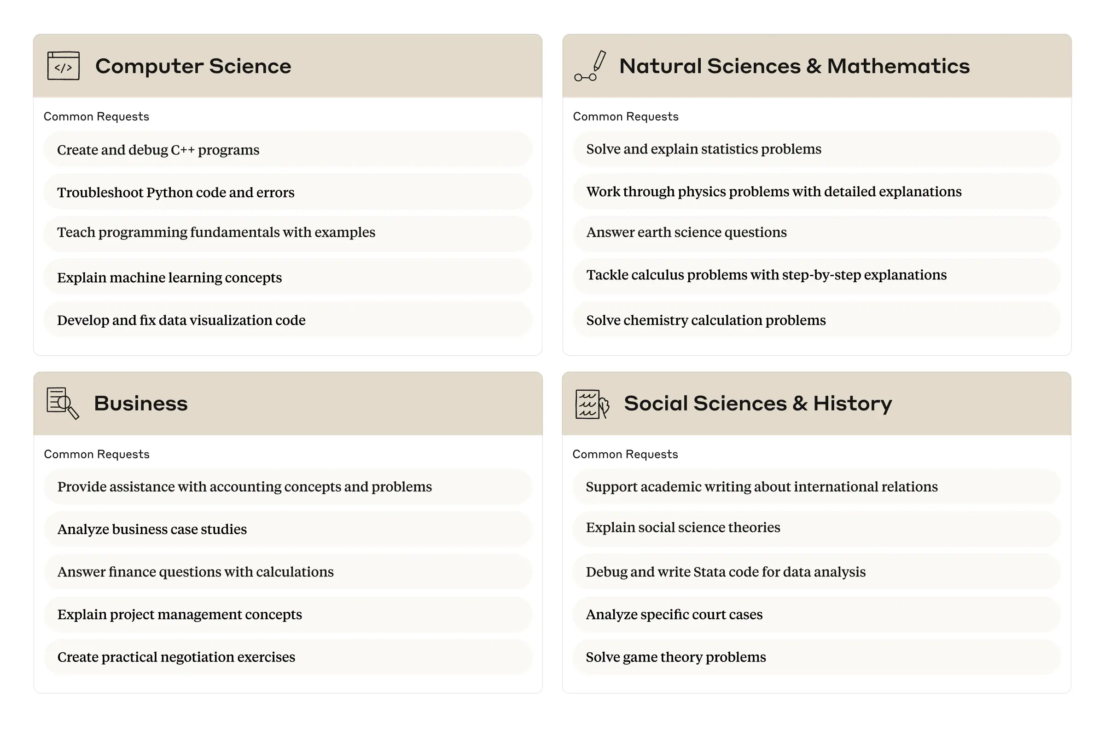

Slide 8
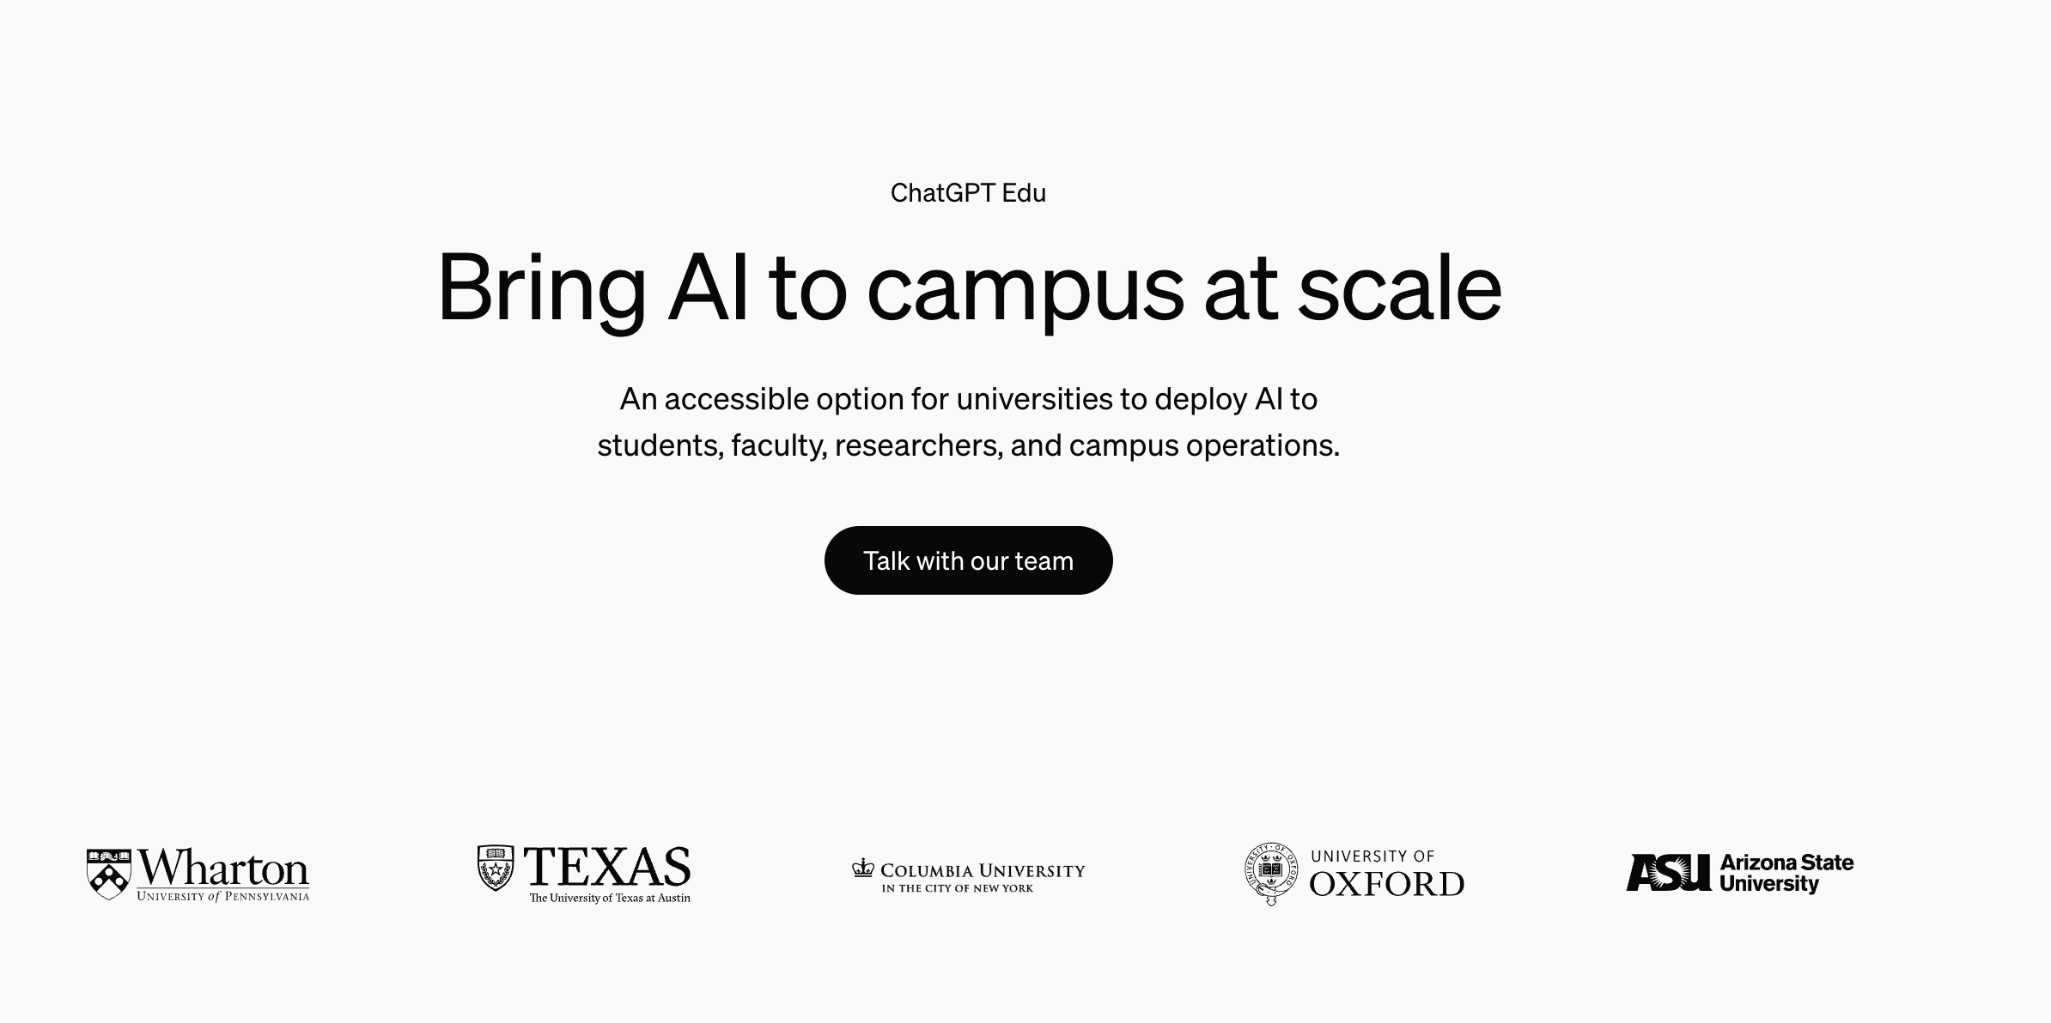

Slide 9


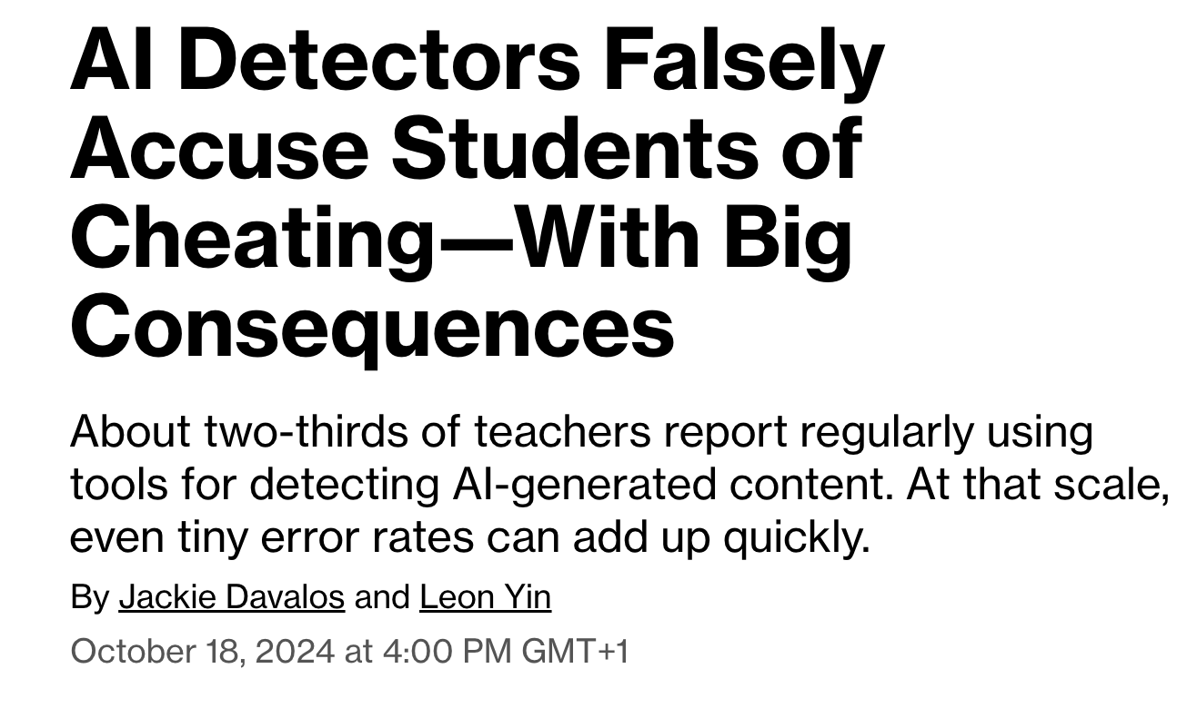
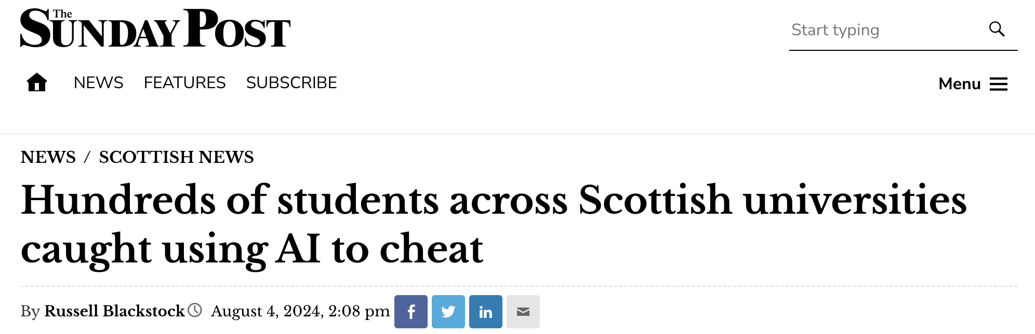



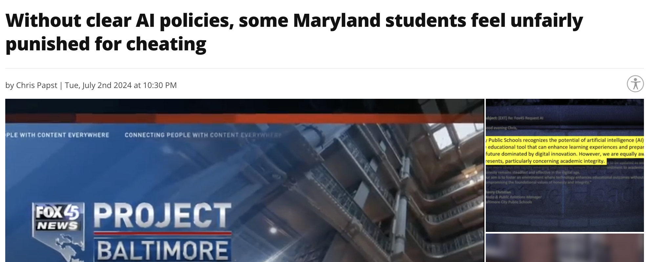
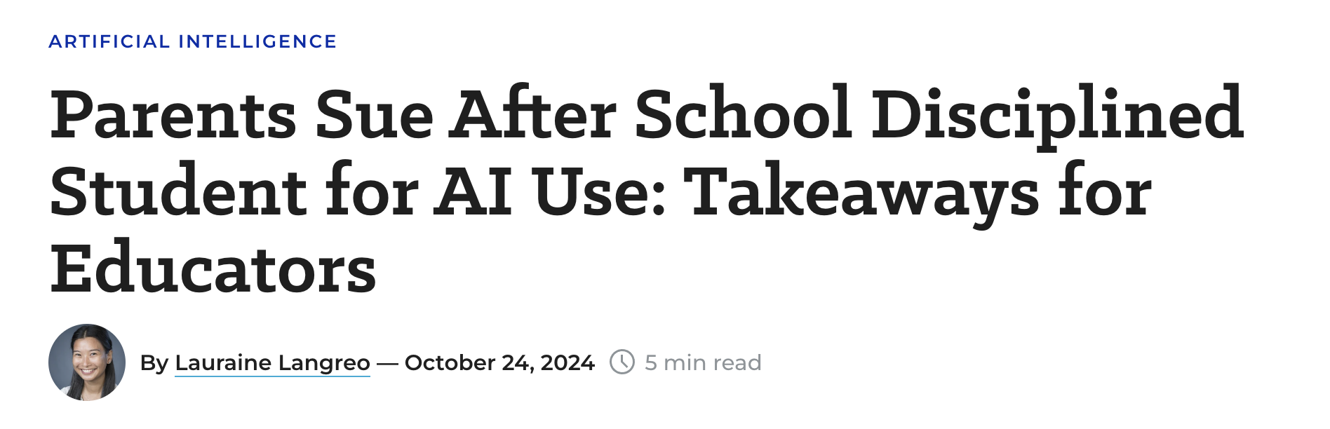


Slide 10


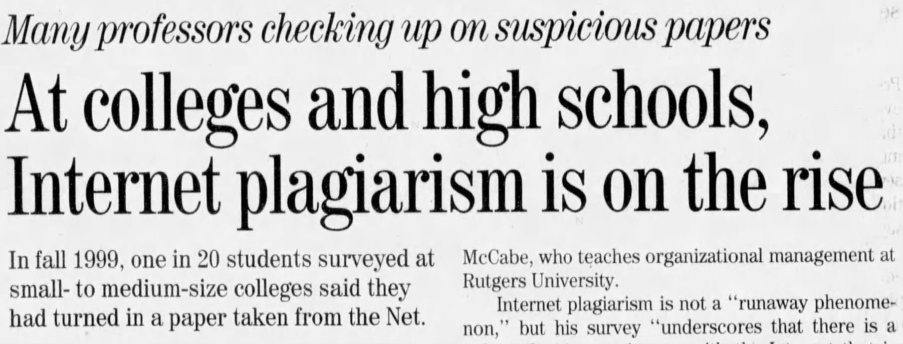

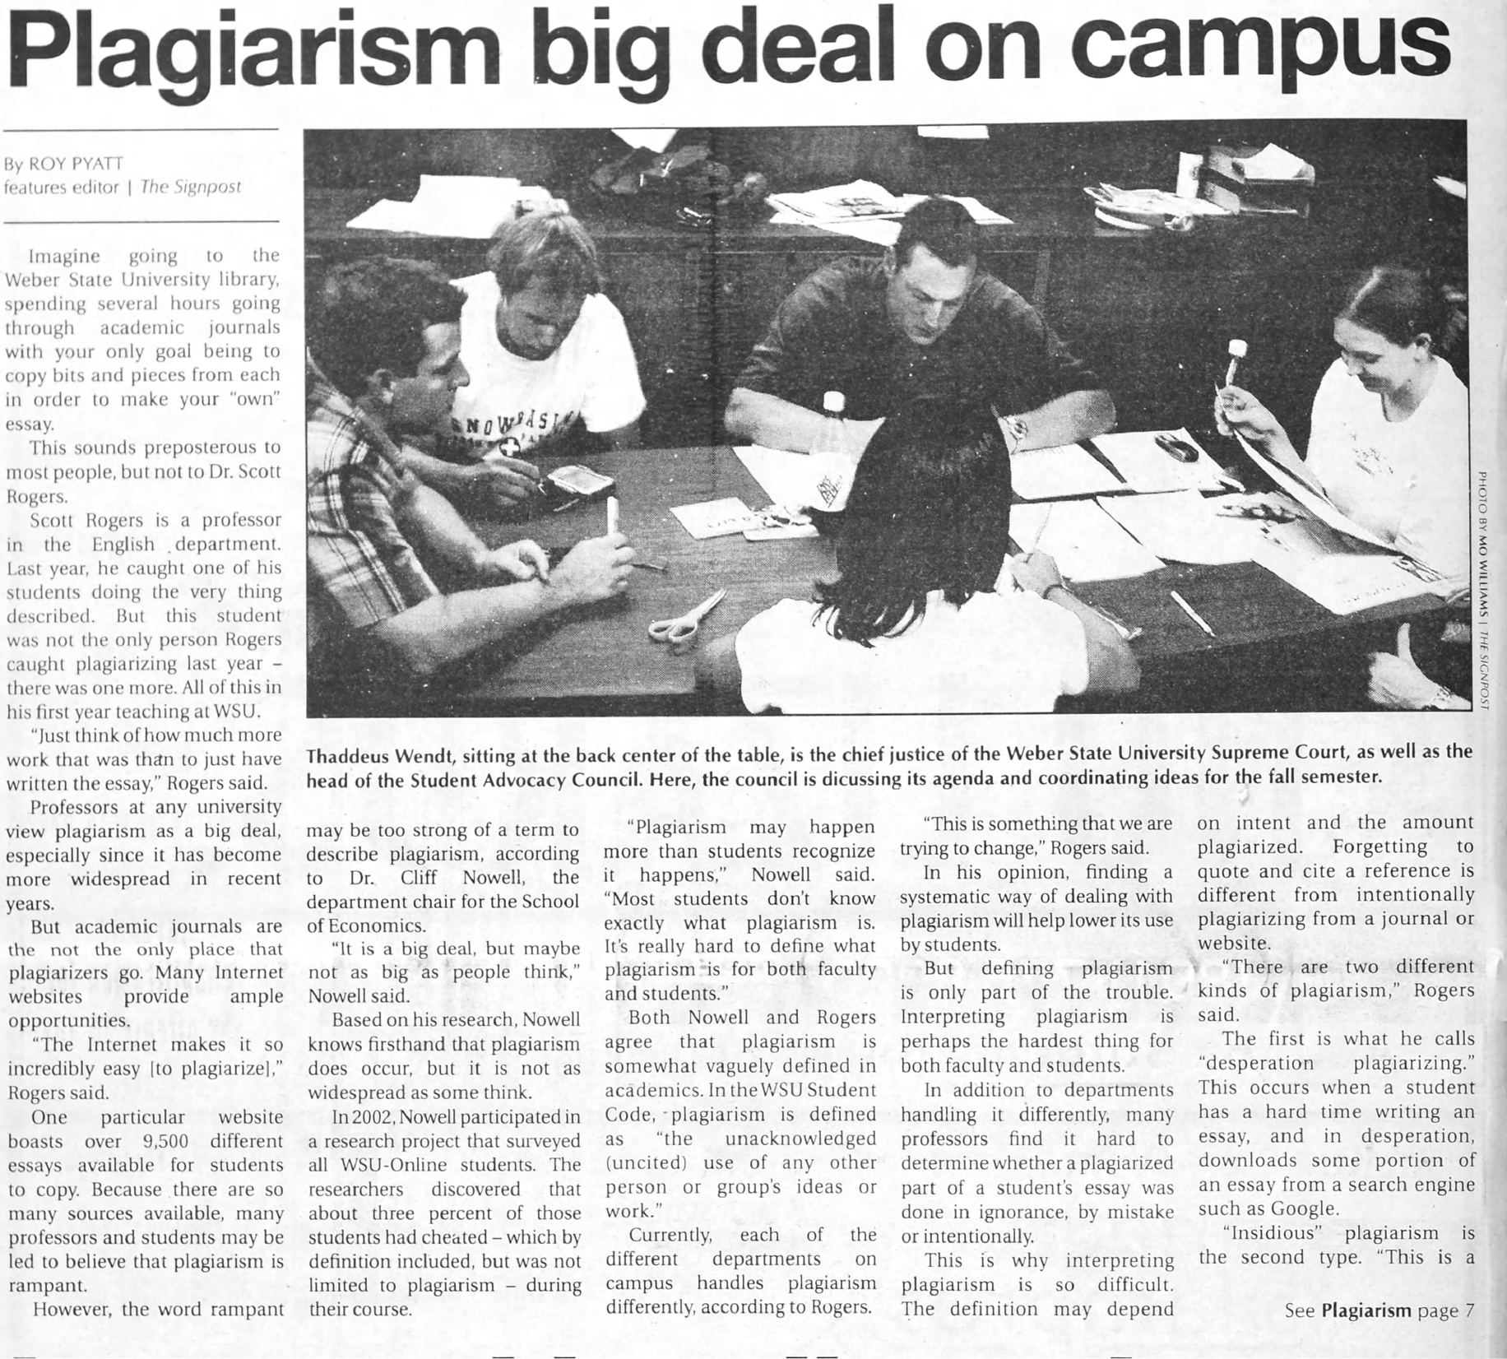
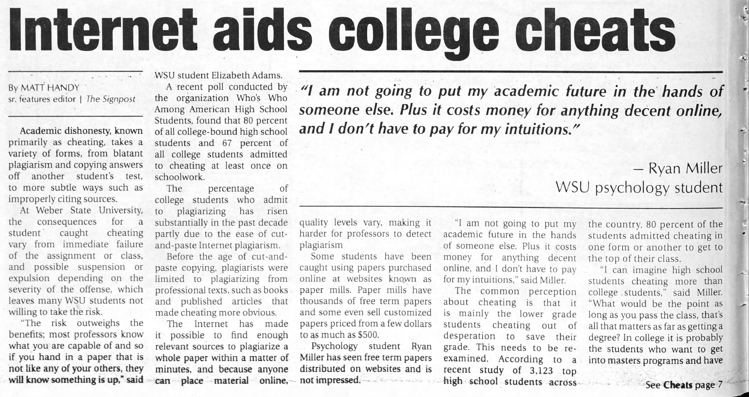

Slide 11


Slide 12
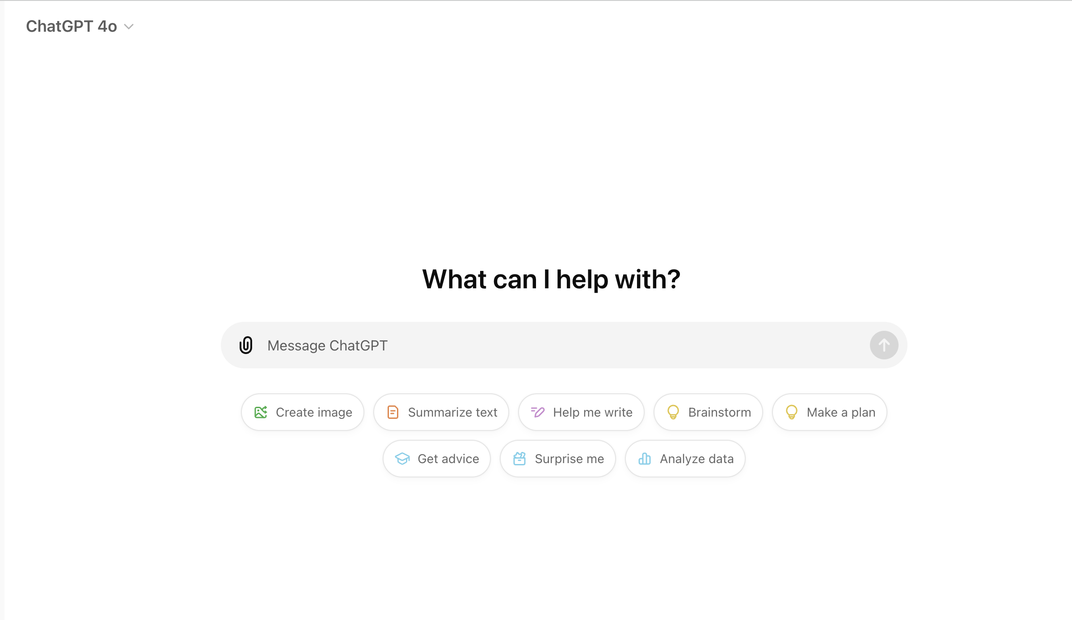

Slide 13
Where do we start?
10%
10%
55%
25%

Slide 14







Prompting
Draft an e-mail for a student who’s
experiencing issues with their admissions journey.
Draft an email for John, a student facing
Admission system processes challenges. He can quickly resolve these issues by referring to the FAQ section on our website.

Slide 15
Developed Prompt
Draft an admissions application instruction email for a group of international students coming on a Business Course for their first year of study at University of Colorado. Use details from the attached spreadsheet, admissions-and-visa guidance document (academic requirements, course-code selection instructions, visa steps). Ensure the e-mail is clear, accessible to a wide range of levels of English and is in line with our university’s tone and global strategy.
Goal
Context
Source
Expectations

Slide 16

Formulating queries
Inspecting Outputs
Responsible use of AI in Research
Subject Matter Expertise
Integrating findings

Slide 17
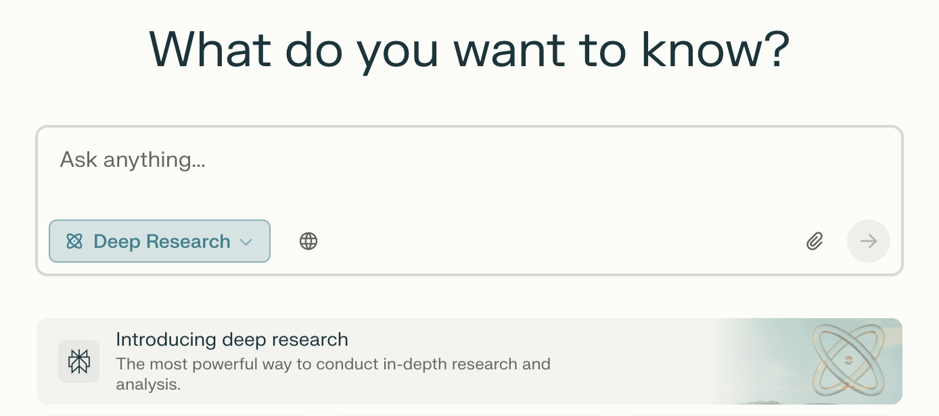
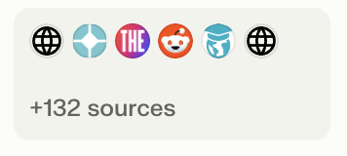
Sample prompt using Perplexity Deep Search
I work for a multidisciplinary university in the UK in the International Office. I need you to research South-East Asia as a market for potentially recruiting international students from the region. Do a proper research by country and give me a full recommendations set of where we should concentrate our student recruitment efforts. Make sure to include stats and actionable insights that we can use to drive our recruitment strategy

Slide 18
Sample prompt using Perplexity Deep Search
I work for a multidisciplinary university in the UK in the International Office. I need you to research South-East Asia as a market for potentially recruiting international students from the region. Do a proper research by country and give me a full recommendations set of where we should concentrate our student recruitment efforts. Make sure to include stats and actionable insights that we can use to drive our recruitment strategy

Slide 19
Report Ready in 10 minutes
Headlines
Outbound Student Growth of 12% Annually (2016–2022) and 18% Choosing the UK
Thailand: Outbound Mobility Grew by 11% Annually Since 2016, with 22,000 Studying Abroad in 2022
Indonesia: 5,200 Outbound Students in 2022, with 43% Going to Australia
Singapore: 82% of Students Abroad Pursue Postgraduate Research, and 67% Prioritize Industry Partnerships
The Philippines : 4,800 Students Abroad in 2022, with 9% Choosing the UK
Myanmar: Outbound Student Numbers Dropped from 6,200 in 2019 to 900 in 2022

Slide 20
However…
Claim | Status | Issue
UK’s share of SEA students declined 3.2% annually (2015–2019) | ❌ Fabricated | No official source confirms this percentage.
Malaysia: 15,000 students abroad in 2022, 35% to the UK | ❌ Fabricated | No 2022 breakdown available.
Vietnam: 12% annual growth (2016–2022), 7,300 students abroad, 18% to UK | ❌ Fabricated | No official source confirms exact figures.
Thailand: 11% annual growth since 2016, 22,000 students abroad in 2022 | ❌ Fabricated | No official report supports these numbers.
Indonesia: 5,200 students abroad in 2022, 43% to Australia | ❌ Fabricated | No source verifies exact numbers or percentages.
Singapore: 82% of outbound students in postgraduate research, 67% prioritize industry partnerships | ❌ Fabricated | No data confirms these specific statistics.
Philippines: 4,800 students abroad in 2022, 9% choosing the UK | ❌ Fabricated | No CHED or UNESCO data verifies this.
Myanmar: Outbound students dropped from 6,200 in 2019 to 900 in 2022 | ❌ Fabricated | No source confirms exact numbers.

Slide 21

Thank you
Questions?

